Slide 1
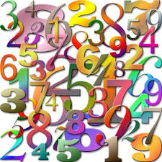
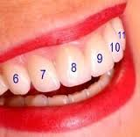
TOOTH IDENTIFICATION & NUMBERING
Dr. Rhythm
Assistant Professor

Slide 2
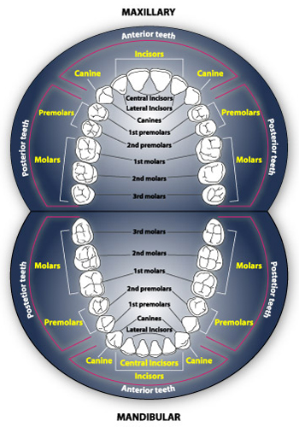
The Dental Arch
The human dentition:
20 primary & 32 permanent teeth

Slide 3
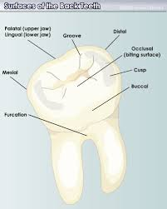
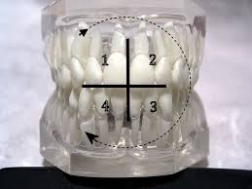
Surfaces & Quadrents

Slide 4
Introduction
Learning nomenclature is the first step in understanding dental anatomy. Tooth numbering or “shorthand” system of tooth notation is necessary in clinical practice for recording data and communication.
The various tooth notation systems are as follows:
Palmer notation system
Universal notation system
FDI system

Slide 5
Palmer notation system
In 1861 Adolph Zsigmondy of Vienna introduced the symbolic system for permanent dentition. He then modified it for the primary dentition in 1874. The symbolic system is now commonly referred to as the Palmer notation system or Zsigmondy system.
Also called Angular or Grid system

Slide 6
Primary teeth- EDCBA ABCDE
EDCBA ABCDE
Permanent teeth 87654321 12345678
87654321 12345678

Slide 7
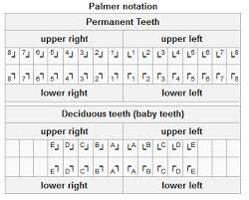

Slide 8
Advantages of Palmer
1. simple to use
2. No confusion between primary & permanent dentition

Slide 9
Disdavntages
1. Oral communication is difficult
2. Opposing or contralateral teeth are indicated by same number or alphabet which is confusing.

Slide 10
UNIVERSAL SYSTEM
ADA officially recommended the Universal system in 1968.
In this system for the permanent dentition the maxillary teeth are numbered through 1 to 16 beginning with upper right third molar.
The mandibular teeth are numbered through 17 to 32 beginning with lower left third molar. The universal system notation for primary dentition utilises upper case alphabets.

Slide 11
Universal notation system
Primary teeth- ABCDE FGHIJ
TSRQP ONMLK
Permanent teeth-
1 2 3 4 5 6 7 8 9 10 11 12 13 14 15 16
32 31 30 29 28 27 26 25 24 23 22 21 20 19 18 17

Slide 12
In this system, the teeth that should be there are numbered. If you are missing your third molars, your first number will be 2 instead of 1, acknowledging the missing tooth. If you’ve had teeth removed or teeth missing, the missing teeth will be numbered as well.

Slide 13
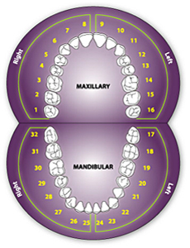
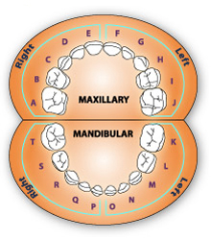
UNIVERSAL NOTATION

Slide 14
Advantages ADA
1. Each tooth has a separate unique letter or number to denote it.

Slide 15
Disadvantages
1. Difficult to remember letters or numbers of individual teeth.

Slide 16
FDI system (Federation Dentaire Internationale)(Two Digit Notation)
The FDI system is a two digit system that has been adopted by WHO .
In this system the first digit indicates the quadrant and the second digit indicates the tooth within the quadrant. 1 to 4 and 5 to 8 as the first digit indicates permanent and primary dentition respectively.
1 to 8 and 1 to 5 as the second digit indicates permanent and primary teeth respectively.

Slide 17
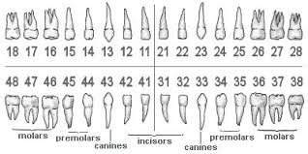

Slide 18
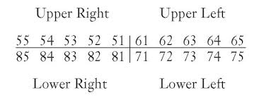

Slide 19
Advantages
1. Each tooth has a separate number.
2. Simple to understand and teach.
3. Esay to pronounce in conversation.
4. Easy to transmit over computer & easy fr charting.

Slide 20
Disadvantages
1. May be confused with ADA numbers.

Slide 21
MCQs
Q. 1 Oldest system for notation is
A. Palmer
B. ADA
C. FDI
D. Universal

Slide 22
Q.2 Grid system is another name for
A. Universal
B. ADA
C. FDI
D. Palmer/Zsigmondy

Slide 23
Q.3 ADA system is anoter name for
A. Universal system
B. Angular system.
C. Grid system
D. FDI notation.

Slide 24
Q.4 Primary dentition consists of
A. 20 teeth
B. 22 teeth
C. 30 teeth
D. 32 teeth

Slide 25
Q.5 Which system is confused with ADA system
A. FDI system
B. Universal system
C. Grid system
D. Angular system

Slide 26
Q. 6 Which system can be transmitted over computer
A. FDI
B. ADA
C. Grid
D. Angular

Slide 27
Q.7 If maxillary right third molar is missing counting in ADA starts from
A. 1
B. 2
C. 3
D. 4

Slide 28
Q.8 Which system is called Two Digit notation
A. FDI
B. ADA
C. Grid
D. Angular

Slide 29
Q.9 Maxillary right central incisor will be numbered as…. In ADA notation
A. 6
B. 7
C. 8
D. 9

Slide 30
Q.10 Maxillary right central incisor will be denoted as…. In FDI notation
A. 11
B. 21
C. 31
D. 41

